Slide 1
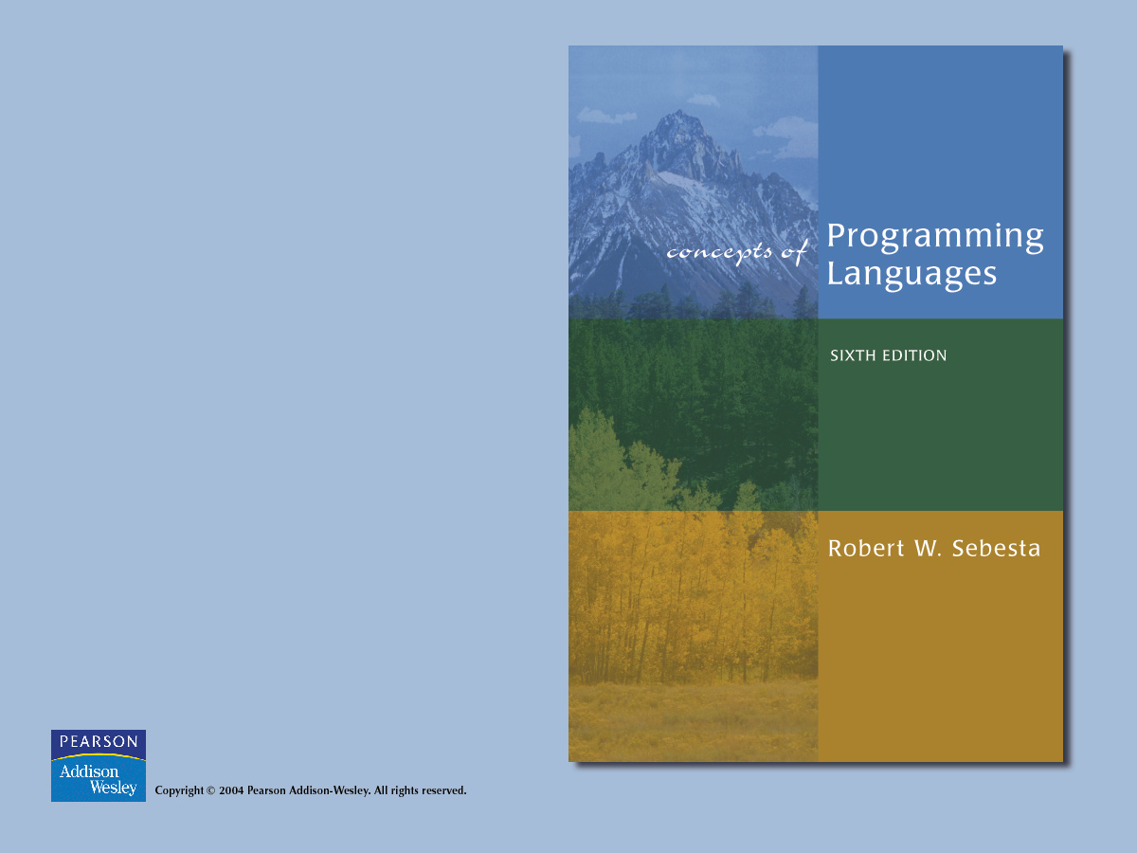
Chapter 1
Preliminaries

Slide 2

Chapter 1 Topics
Motivation
Programming Domains
Language Evaluation Criteria
Influences on Language Design
Language Categories
Language Design Trade-Offs
Implementation Methods
Programming Environments

Slide 3
Motivation: Why Study Programming Languages?
Increased ability to express ideas
Improved background for choosing appropriate languages
Greater ability to learn new languages
Understand significance of implementation
Ability to design new languages
Overall advancement of computing

Slide 4
Programming Domains
Scientific applications
  Large number of floating point computations
Business applications
  Produce reports, use decimal numbers and characters
Artificial intelligence
  Symbols rather than numbers manipulated
Systems programming
  Need efficiency because of continuous use
Scripting languages
  Put a list of commands in a file to be executed
Special-purpose languages

Slide 5
Language Evaluation Criteria
Readability
  The most important criterium
  Factors:
    Overall simplicity
      Too many features is bad
      Multiplicity of features is bad
    Orthogonality
      Makes the language easy to learn and read
      Meaning is context independent
      A relatively small set of primitive constructs can be combined in a relatively small number of ways
      Every possible combination is legal
      Lack of orthogonality leads to exceptions to rules

Slide 6
Language Evaluation Criteria
  Readability factors (continued)
    Control statements
    Defining data types and structures
    Syntax considerations
      Identifier forms
      Special words
      Form and meaning

Slide 7
Language Evaluation Criteria
Writability
  Factors:
    Simplicity and orthogonality
    Support for abstraction
    Expressivity
Reliability
  Factors:
    Type checking
    Exception handling
    Aliasing
    Readability and writability

Slide 8
Language Evaluation Criteria
Cost
  Categories
    Training programmers to use language
    Writing programs
    Compiling programs
    Executing programs
    Language implementation system
    Reliability
    Maintaining programs
Others: portability, generality, well-definedness

Slide 9
Influences on Language Design
Computer architecture: Von Neumann
We use imperative languages, at least in part, because we use von Neumann machines
  Data and programs stored in same memory
  Memory is separate from CPU
  Instructions and data are piped from memory to CPU
  Basis for imperative languages
    Variables model memory cells
    Assignment statements model piping
    Iteration is efficient

Slide 10

Von Neumann Architecture

Slide 11
Influences on Language Design
Programming methodologies
  1950s and early 1960s: Simple applications; worry about machine efficiency
  Late 1960s: People efficiency became important; readability, better control structures
    Structured programming
    Top-down design and step-wise refinement
  Late 1970s: Process-oriented to data-oriented
    data abstraction
  Middle 1980s: Object-oriented programming

Slide 12
Language Categories
Imperative
  Central features are variables, assignment statements, and iteration
  C, Pascal
Functional
  Main means of making computations is by applying functions to given parameters
  LISP, Scheme

Slide 13
Language Categories
Logic
  Rule-based
  Rules are specified in no special order
  Prolog
Object-oriented
  Encapsulate data objects with processing
  Inheritance and dynamic type binding
  Grew out of imperative languages
  C++, Java

Slide 14
Language Design Trade-Offs
Reliability vs. cost of execution
Readability vs. writability
Flexibility vs. safety

Slide 15

Layered View of Computer

Slide 16
Implementation Methods
Compilation
  Translate high-level program to machine code
  Slow translation
  Fast execution

Slide 17

Compilation Process

Slide 18
Implementation Methods
Pure interpretation
  No translation
  Slow execution
  Becoming rare

Slide 19

Pure Interpretation

Slide 20
Implementation Methods
Hybrid implementation systems
  Small translation cost
  Medium execution speed

Slide 21

Hybrid Implementation System

Slide 22
Programming Environments
The collection of tools used in software development
UNIX
  An older operating system and tool collection
Borland JBuilder
  An integrated development environment for Java
Microsoft Visual Studio.NET
  A large, complex visual environment
  Used to program in C#, Visual BASIC.NET, Jscript, J#, or C++

